Slide 1

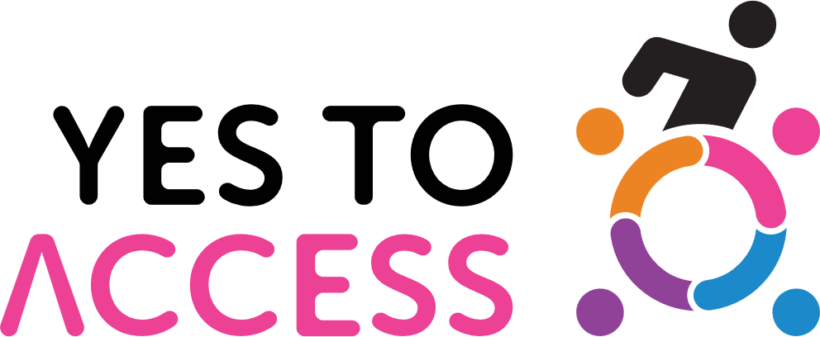


Slide 2
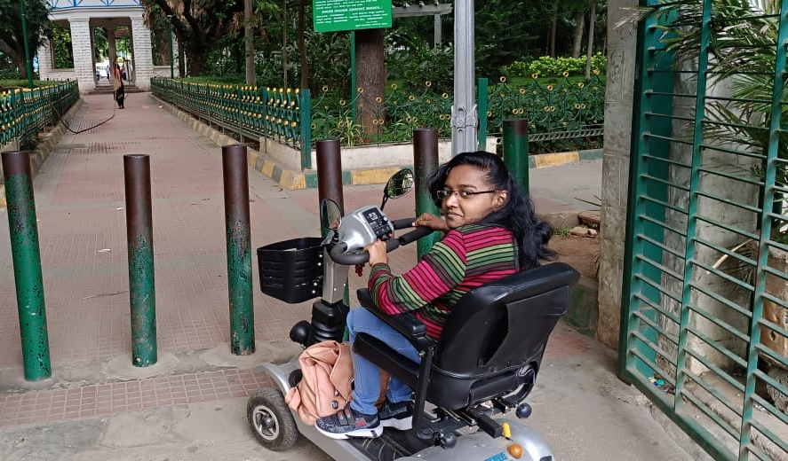
What is Yes To Access?
A volunteer driven movement for a more Inclusive India
Yes to Access is an APD initiative promoting universal accessibility and inclusion by transforming public spaces, transport, and digital platforms to be barrier-free for persons with disabilities.

Slide 3

About The Association of People with Disability (APD)
APD is a 66 year old NGO, working across the lifecycle of persons with disability
We are fully compliant with all prevailing government regulations
We are managed by an independent Board and eminent Trustees
APD is a valued partner of the the Election Commission; various state and central government consultative committees
In FY 24-25, APD touched the lives of over 400,000 persons
APD and YesToAcces is a partner with the Ministry of Social Justice, Government of India’s Sugamya Bharat 2.0

Slide 4

Yes To Access – an introduction
The Problem:
  Public spaces in India are not designed for access by Persons with Disability and the elderly
  Digital websites and Apps are not designed to global accessibility standards making it hard for the disabled to participate in Digital India
  Public Transport vehicles and transportation infrastructure like bus stands and railway stations are not fully accessible
  Large numbers of disabled students and employees drop out because their places of study and work have not been adapted for equal access
  Accessibility is therefore a foundational principle before true diversity and inclusion can be practiced

Slide 5
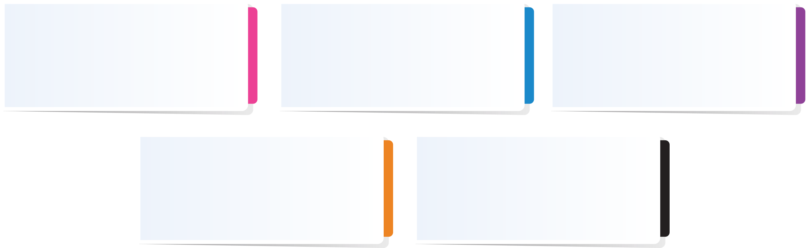
The current situation in India
75 years after we adopted our constitution – “We the People…” the disabled are still denied equality of opportunity
Rights of Persons with Disabilities Act passed in 2016 making discrimination, in any form, illegal
Hon’ble Prime Minister gives call for Sugamya Bharat Abhiyan or Accessible India campaign in 2016
National Building Code makes recommendations for accessible infrastructure and standards
Progress on the ground has been slow; awareness remains miniscule

Slide 6







Strong alignment to UN’s SDG 2030
India develops SDG Index to track progress on UN’s Sustainable Development Goals 2030
India is a signatory to the United Nations Convention on the Rights of Persons with Disability, 2007 (UNCRPD) which aims to ensure that people with disabilities have the same rights and freedoms as everyone else.
Supreme Court rules that accessibility is a fundamental human right

Slide 7


Yes To Access Thematic Areas
BUILT
DIGITAL
MOBILITY
Select website
Canvas website owner
Audit with YTA app
Upload to AI engine
Accessibility Data on map
Run audit
tool

Slide 8

Yes To Access - A flexible volunteering program
Designed to be adaptable for your volunteering needs
Select one or more areas – Built, Digital or Mobility
Online Sensitisation and Training by APD
  60 minutes workshop
Flexi personnel
Anyone can participate
Flexi time
Can be done at any time of the volunteer’s choosing – office hours or after hours
Flexi duration
Ten minutes or three hours – infinitely adaptable to the time available
Flexi location
Can be done at the workplace or at home - anywhere in India or the world
Flexi size
Can be done individually or as a group activity

Slide 9
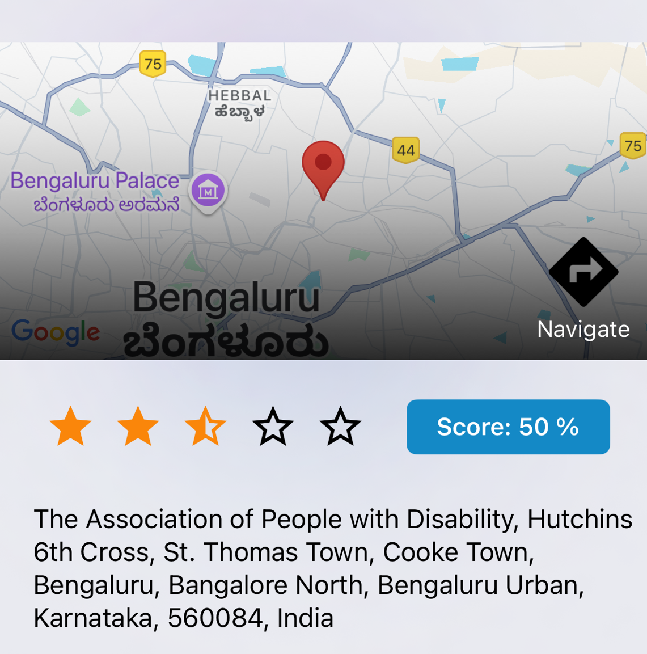
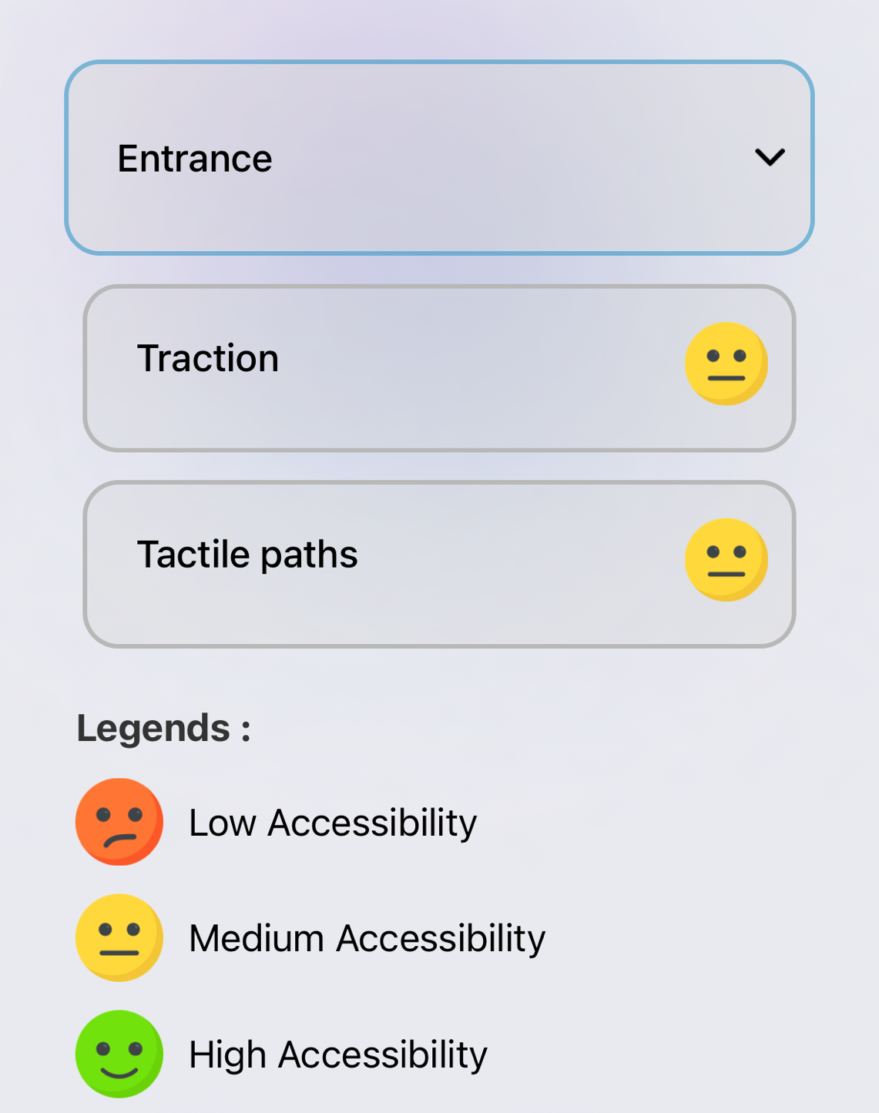
What is the impact volunteers will create?
Building a Digital Public Good: Volunteer-uploaded pictures and audits contribute to an accessibility rating system, forming a crucial layer of an open digital map for the elderly, disabled, and caregivers.
Drives employee engagement and measurement through a real-time activity dashboard.
Fosters awareness and empathy around barriers faced by the elderly and persons with disabilities.
Encourages a citizen-led movement that creates social pressure, often more effective than regulations.
Amplifies citizen voices in boardrooms and policy spaces.

Slide 10
Is any payment required ?
Yes To Access campaign has a variety of expenses – organisational, technology, communications, personnel
Your financial contribution will help us expand the program
There is no payment required for participation
Donations are welcome to support, expand and grow this campaign
  Employee giving – please go to https://www.apd-india.org/donation/
  CSR giving – please write to us at yestoaccess@apd-india.org
  We are FCRA, 12A and 80G certified and fully compliant with all regulations
  If you wish to have a specifically tailored volunteer or giving program,
  write to us yestoaccess@apd-india.org

Slide 11
Is it a one-time activity?
Audit drives can be repeated multiple times at your convenience
Yes To Access is a citizen volunteer movement and we need thousands of volunteer auditors across India
Yes To Access provides multiple ways in which volunteers can engage and contribute
We welcome your employees’ ideas and creativity to make this movement viral
Hackathons, blogs, social media advocacy, training and championing the cause are all welcome.

Slide 12
Examples of follow - on projects
  Write and nudge your own organisation to become more inclusive and have accessible infrastructure – your buildings, websites, apps, buses
  Campaign to urge your favourite brands to make their facilities more accessible, and thereby truly inclusive
  Audit popular websites and write to the site owner to adapt their site to make it accessible to all citizens, irrespective of disability
  Publicise the Yes To Access campaign in social media and on your handles
  Become a YTA organizer and champion – organise schools, college students, social clubs – we can’t do this alone.

Slide 13
How do you get started?
Audit drives are flexible – volunteers can audit anytime, as many times as they like.
Multiple ways to contribute – from audits and social media advocacy to blogs, hackathons, and training sessions.
Get creative – your team’s ideas can help make this movement go viral!
Track your impact – full traceability of contributions is available.
Get recognized – earn certificates and badges based on audits completed.
Onboard us as a volunteering partner – we’ll guide you through the simple sign-up process.
Schedule a 60-minute training session – we’ll equip your trainers or volunteers to get started.

Slide 14
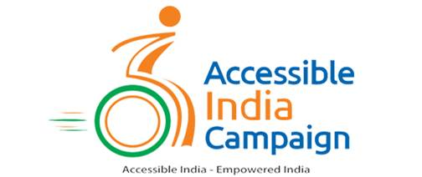
Volunteering that makes a REAL difference
Join us to create a barrier free, truly inclusive India by 2030

Slide 15





What is the story behind our logo ?
The four coloured segments and dots represent the able population
The interlocked arms represent the crowdsourced, volunteer driven design
The uplifted figure and the circle represent the international symbol of disability
The composite symbol represents the dream of a more inclusive India
The five colours symbolise the five major disability groups – locomotor, speech, hearing, visual and mental disability

Slide 16
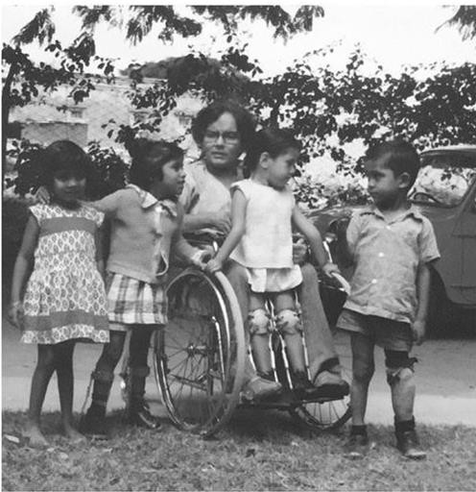
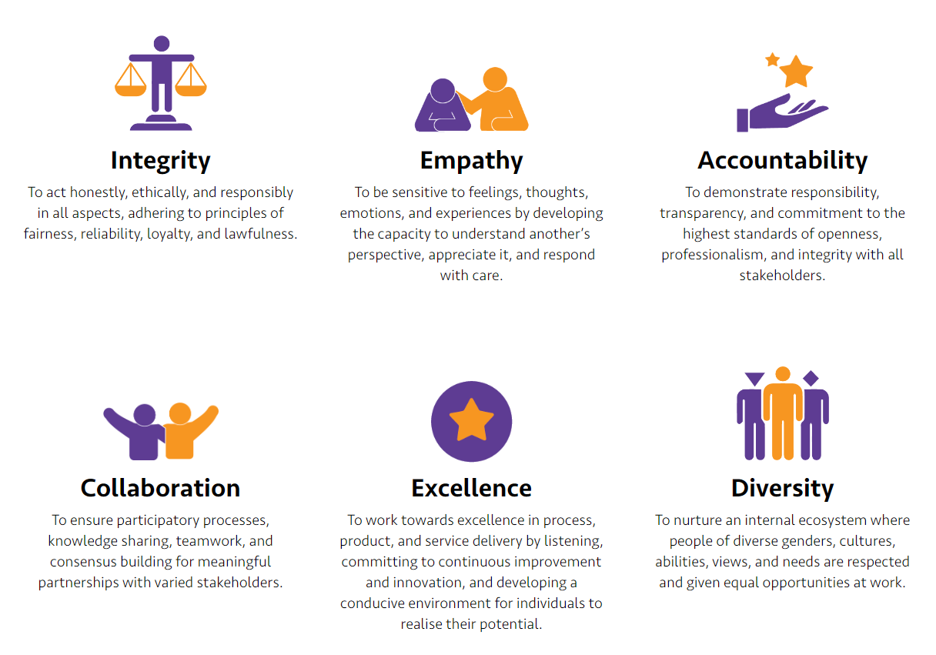
Our Guiding Fundamentals
Vision
A world where equity, dignity and justice are assured for people with disability.
Mission
Nurture an inclusive ecosystem and empower people with disabilities with access to comprehensive rehabilitation services, rights, entitlement, equal opportunities and dignity through a lifecycle approach.

Slide 17
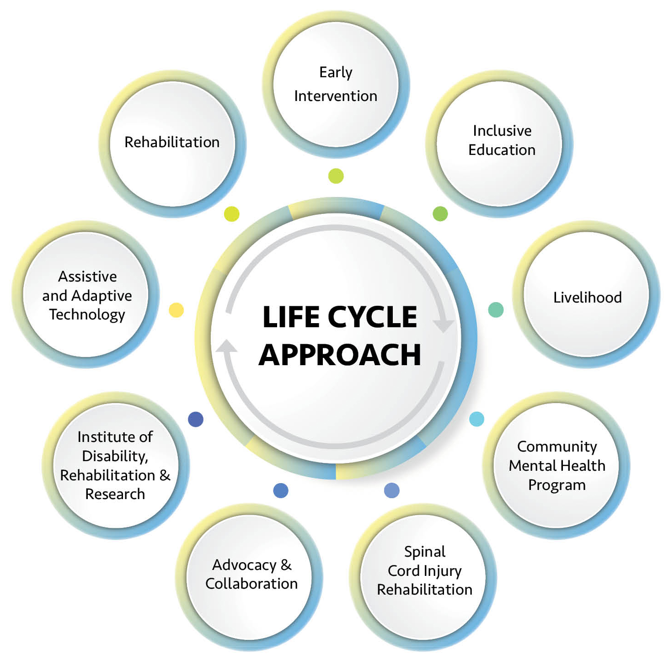
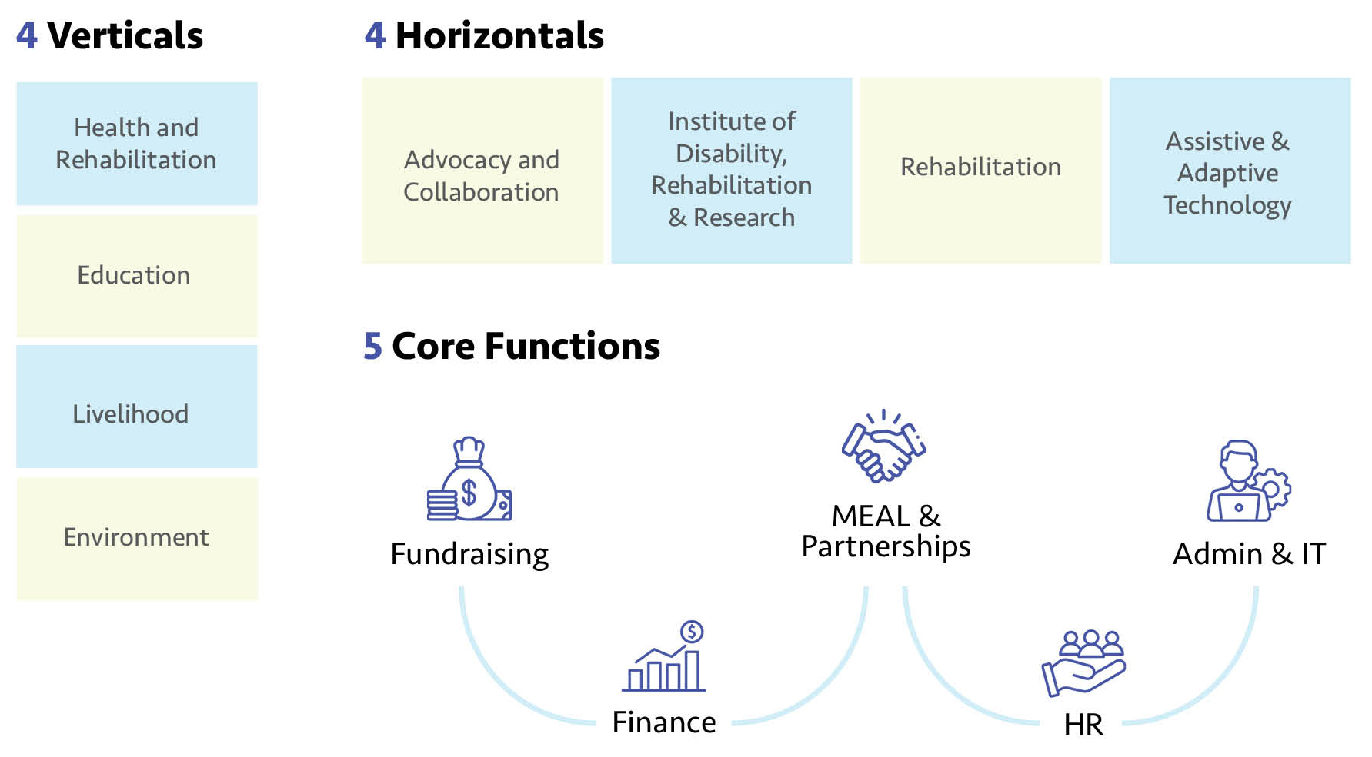
APD Departments

